Slide 1





Building a pilot production platform for the manufacture of CNT-based nano-enabled products: the experience of the project PLATFORM, and beyond
Workshop on Safety Aspects in Pilot Lines
Nanosafe 2018, Grenoble, 7th October 2018
Jesús M. López de Ipiña and Sonia Florez
TECNALIA Research and Innovation
Industry and Transport Division
PLATFORM has received funding from the European Union’s Horizon 2020 research and innovation programme under grant agreement No 646307.

Slide 2


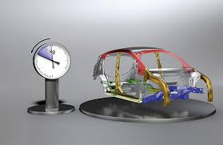
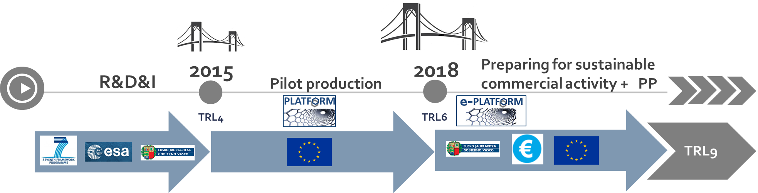

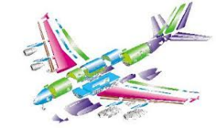
The underlying need
PROBLEMS:
Different properties: composites do not conduct electricity or heat as metal does
Nanotechnology (CNTs) cannot easily be introduced into composites supply
Lack of industrial scale manufacturing of nano-enabled composites products
Not sufficient quantities are currently produced for the automotive & aerospace industry
High Cost of intermediate nano-enabled composites products, especially for SMEs
Tailored solution for each application: different chemical content, production process, etc
Limited accessibility to SME producers
EHS issues
EU objectives and regulations
Use of lightweight materials
Replace metals with composites
Workshop on Safety Aspects in Pilot Lines - Nanosafe 2018, Grenoble, 7th October 2018

Slide 3

The Project PLATFORM in short
Open access pilot plants for sustainable industrial scale nanocomposites manufacturing based on buckypapers, doped veils and prepregs (PLATFORM)
Call for proposal | H2020-NMP-PILOTS-2014
Topic | NMP-01-2014 - Open access pilot lines for cost-effective nanocomposites
Funding scheme | RIA - Research and Innovation action
From / To | 2015-02-01 / 2018-01-31 (Closed Project)
Duration | 36 months
Total cost | EUR 7 797 727,50
EU contribution | EUR 7 797 727,50
Coordinator | FUNDACION TECNALIA RESEARCH & INNOVATION (Spain)
To develop pilot lines for the industrial production of CNT-based nano-enabled products for composite applications in aeronautic and automotive.
To efficiently and economically manufacture NEP-based components at a scale suitable for industrial uptake.
To create a European platform of pilot lines, open-access to companies and more particularly SMEs

Slide 4

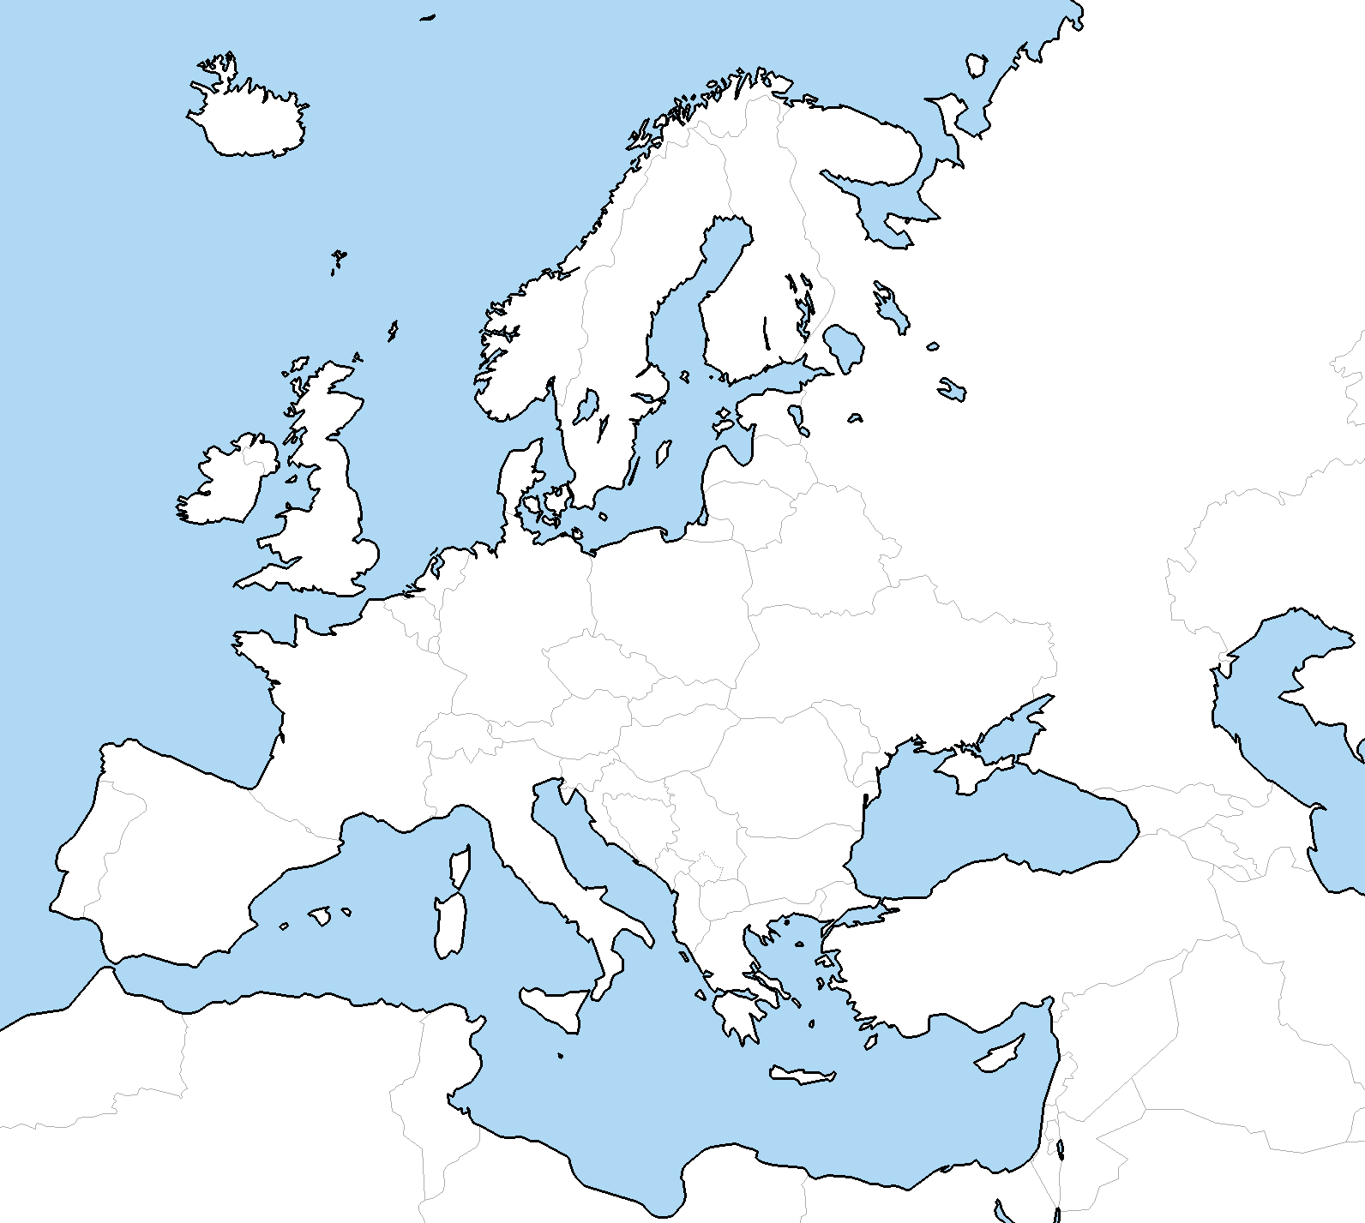










The results: e-PLATFORM Products & Services
e-Platform is a joint venture which provides nano-enabled advanced composites solutions for parts manufacturers, mainly SMEs (www.nanocomposites-hub.com)
PPL3
Products
PPL1
Renting Facilities
(Warsaw, POLAND)
PPL2
R&D Services
(San Sebastián, SPAIN)
(Patras, GREECE)
Training
The PLATFORM ecosystem for pilot production consists of three open pilot lines for the manufacture of pre-commercial CNT-BASED NANO-ENABLED PRODUCTS, for composite applications in the aeronautics and automotive industries.

Slide 5
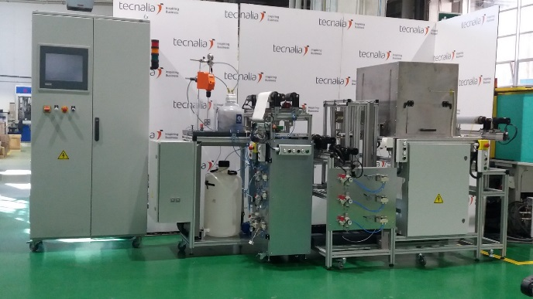
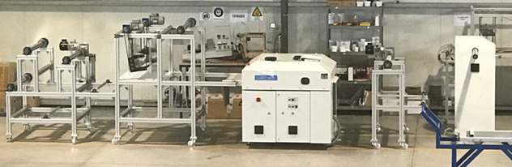
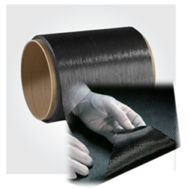
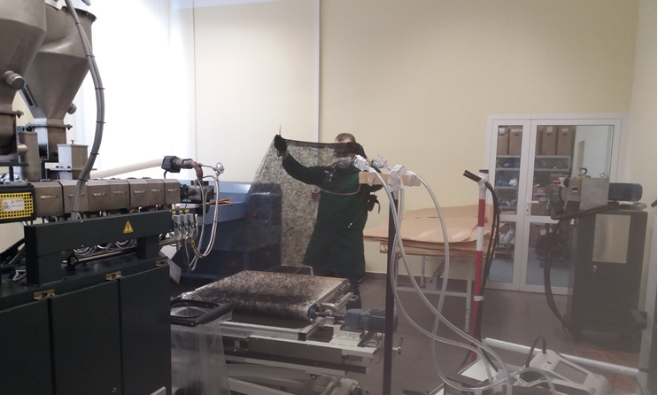

The PLATFORM ecosystem for pilot production
PLATFORM Pilot Line 1 Buckypapers
(Vacuum filtration)
PC: 2 m²/day
TRL 6
Bucky papers are a continuous self-supporting thin sheet/membrane consisting of 100 % of entangled CNTs
CNT waterbone dispersion
TRL 6
Rolls, flexible formats
TRL 6
PLATFORM Pilot Line 2
CNT-doped prepregs
(Hot pressed)
PC: 500 m²/day
CNT-prepregs are commercial carbon fiber prepregs doped with CNTs
CNT-TP powder
TRL 6
Rolls, flexible formats
PLATFORM Pilot Line 3
CNT-doped veils
(Melt-blown)
PC: 50 m²/day
TRL 5
CNT-veils are an ultralight polymer nonwoven fabric, consisting of thin fibers bonded together thermally which are spread randomly in the web.
CNT-TP masterbatch
TRL 5
Sections 1,5 m²
Workshop on Safety Aspects in Pilot Lines - Nanosafe 2018, Grenoble, 7th October 2018

Slide 6


What we have done: the nanosafety strategy deployed by PLATFORM
STARTING POINT
Pilot Lines are NEW MACHINERY
Machinery/Processes (PPLs) are the PRIMARY SOURCE of emissions, wastewater and waste in industry, with potential environmental and occupational impacts.
The manufacture of NEW MACHINERY is regulated in Europe by the MACHINERY DIRECTIVE 2006/42/EC.
PPLs are not required to comply with the provisions of the MD until they are PUT INTO SERVICE and made available to workers (expected in 2020); but MANDATORY in 2020.
NANOSAFETY STRATEGY
SAFE BY DESIGN APPROACH: Use the ROBUST SbD methodological approach established by the MD to integrate all nanosafety aspects of the pilot lines, from the early stages of the design (Preventive approach).
FOCUSED ON: EHSRs linked with nanosafety (e.g. materials and products used/created; risks due to emissions of hazardous materials and substances).
METHODOLOGY: Training participants, Risk assessment, EHS specifications, Measurement campaigns (Budget availability).
METHODS AND TOOLS:
Standardization (CEN, ISO): EN ISO 12100, EN ISO 14123, ISO 12901-2, ISO/TR 18637, EN689, EN 17058
Reference documents: NIOSH-CNTs, WHO Guidelines
Tools: PLATFORM SbD Tool, NanoReg2 (Product), EC website.
MSDS: Involvement of a sound CNT manufacturer with relevant expertise in nanosafety.
Measurement campaigns (aerosols) : focused on hot spots
6. Our best knowledge, engineering practices and professional judgement for decision making.
Workshop on Safety Aspects in Pilot Lines - Nanosafe 2018, Grenoble, 7th October 2018

Slide 7
OASIS: building tomorrow’s industry
Open Access Single entry point for scale-up of Innovative lightweight Smart composite materials and components (OASIS)
Call for proposal | H2020-NMBP-TO-IND-2018-2020
Topic | DT-NMBP-01-2018 - Open Innovation Test Beds for Lightweight, nano-enabled multifunctional composite materials and components
Funding scheme | IA - Innovation Action
From (Expected date) | 1-01-2019
Duration | 42 months
Total cost | EUR 13 260 110
EU contribution | EUR 11 757 065
Coordinator | FUNDACION TECNALIA RESEARCH & INNOVATION (Spain)
Development and organization of the Open Innovation Testbed (OITB) with 12 PLs
Set-up a Single Entry Point (SEP) for easier access to SMEs and sustainable operation of the OITB service offer
Validation of upscale/upgrade of pilots and services through 6 showcases in high-impact industrial sectors
Set up of Open Calls (OC) to validate the SEP and ensure the sustainability of the OITB ecosystem
Demo-cases development (6 -12).

Slide 8
OASIS´s Vision for sustainable manufacturing
A pilot sustainable manufacturing ecosystem of 12 Pilot Lines, operating under a common and demanding umbrella of Sustainable Production (OASIS base line), to ensure a competitive, quality, safe and environmental friendly production, of nanomaterials and nano-enabled products in compliance with the applicable regulation.
Workshop on Safety Aspects in Pilot Lines - Nanosafe 2018, Grenoble, 7th October 2018

Slide 9
What we want to do: nanosafety in OASIS
Common and demanding EHS rules: OASIS base line
Owners involvement
1
2
OASIS-SMF integrating best QES management practices, STANDARDS, regulatory requirements and existing nanosafety tools.
leadership to improve QES performance, reduce environmental and workplace risks and create safer working conditions.
Customized EHS - starting points and improvement plans
3
4
Continual improvement
Practical implementation of the OASIS-SMF thorough a PDCA cycle of continual improvement.
12 customized EHS diagnosis and improvement Plans.
Research team operating with common EHS-working procedures
Measurement campaigns focused in hot spots
5
6
to compare the results¡¡
based on Risk Assessment, covering all life cycle stages, operation modes, included emergency .
New technical EHS services
7
8
Cooperation
exported into the OITB's catalog of services.
with other research projects (e.g. EC4SafeNano) and the NSC (strengthen the research/market link).
Workshop on Safety Aspects in Pilot Lines - Nanosafe 2018, Grenoble, 7th October 2018
Notes:
We need money for that, significant investment is needed… however, we do not find specific instruments for the follow-up activities.
At this stage of the project, we are trying to identify the best funding instruments for us but this is not an easy task. In our case, the scenario is even more challenging because we are people/companies from different regions. That means that we have different funding instruments, those instruments have different timing, regulations, they cover different activities and it is difficult to coordinate
Our products address different sectors but the main ones would be the aeronautical / aeronautics and the automotive sector. Those sectors need long time to market. They are highly regulated and the products required certifications that take time.
As I said before, we are a research centre and 2 spin-offs,.. We do no have financial muscle to ask for money for the upscaling and to resist / stand many years before entering the market.

Slide 10

Thank you very much for your attention!
CONTACT:
You can find us at:
PLATFORM / OASIS projects: jesus.lopezdeipina@tecnalia.com
sonia.florez@tecnalia.com
www.platform-project.eu
www.nanocomposites-hub.com
(e-PLATFORM)
Project PLATFORM have received funding from the European Union’s Horizon 2020 research and innovation programme, under grant agreement Nº 646307. This presentation reflects only the author’s views and the Commission is not responsible for any use that may be made of the information contained therein.
Workshop on Safety Aspects in Pilot Lines - Nanosafe 2018, Grenoble, 7th October 2018

